Slide 1
Principal Component Analysis (PCA)

Slide 2
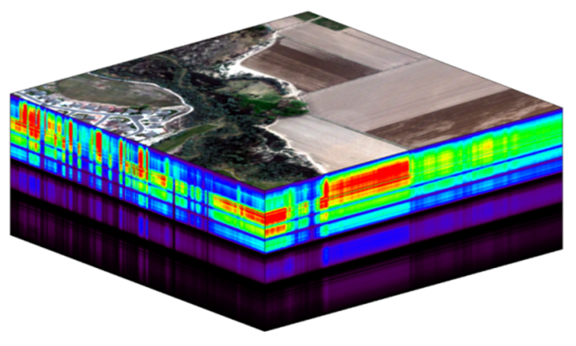
What is Principal Component Analysis?
“Principal component analysis (PCA) is a popular technique for analyzing large datasets containing a high number of dimensions/features per observation, increasing the interpretability of data while preserving the maximum amount of information, and enabling the visualization of multidimensional data.
Formally, PCA is a statistical technique for reducing the dimensionality of a dataset. This is accomplished by linearly transforming the data into a new coordinate system where (most of) the variation in the data can be described with fewer dimensions than the initial data.
Many studies use the first two principal components in order to plot the data in two dimensions and to visually identify clusters of closely related data points. Principal component analysis has applications in many fields such as Population Genetics, Microbiome studies, Atmospheric Science etc.”
NEON hyperspectral remote sensing data;
Each layer in the cube represents a spectral band
https://en.wikipedia.org/wiki/Principal_component_analysis

Slide 3
Numerous PCA Applications
Kinget al. (1997) compiled a large climate data set to examine the relationship between climate variability and lake thermal stratification patterns for South Bay (Lake Huron), Ontario.
mean air temperature
wind speed
monthly prevailing wind direction (eight compass point direction)
percent of total monthly hours that wind blew along the bay's fetch
…….
Monthly mean incoming solar radiation
Ice Julian dates
36 variables spanning 37 years
Use PCA to reduce input data dimension
(Remove redundant information)
Better statistical model and interpretation

Slide 4
PCA as a key data pre-processing step in statistical modelling
EPA Ozone project (1960-1970)
450 meteorological variables for a period of seven years;
Automobile emissions;
Ozone levels
Statistical modelling
High intercorrelations among two or more independent variables
Multicollinearity leads to wider confidence intervals
Model results are difficult to interpret

Slide 5
PCA as a key data pre-processing step in hyperspectral remote sensing
200-400 spectral bands
PCA
~ 10 principal components
Computationally demanding;
Curse of dimensionality
Image classification or object detection

Slide 6
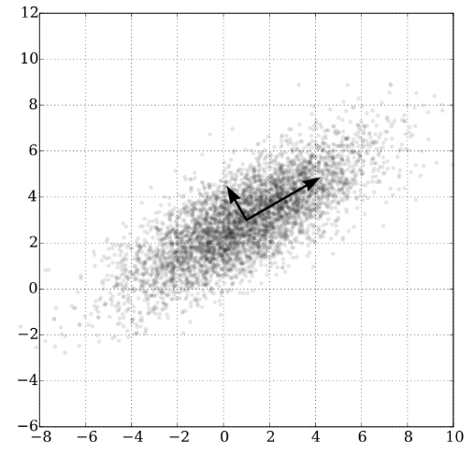

How does PCA work?
PCA generates a new set of variables, called principal components.
Each principal component is a linear combination of the original variables.
All the principal components are orthogonal to each other, so there is no redundant information. The principal components as a whole form an orthogonal basis for the space of the data.
The first principal component retain maximum variation in the original data. The second PC retain second most variation……
Image from https://towardsdatascience.com/principal-component-analysis-explained-d404c34d76e7

Slide 7
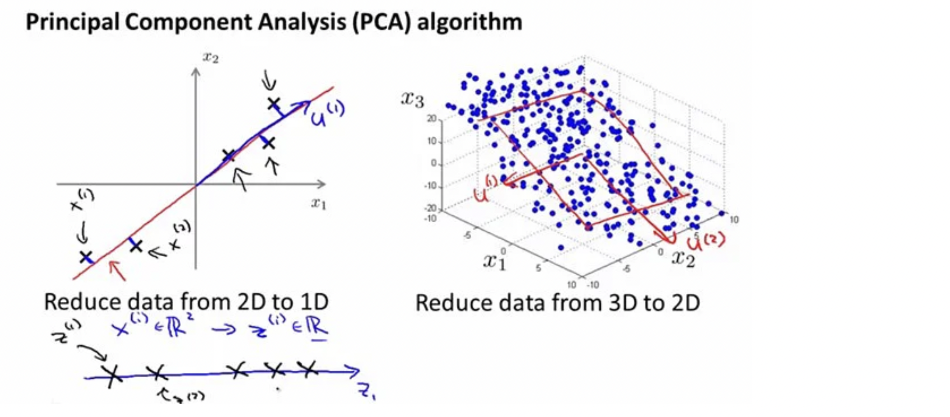
Image from Andrew NG’s machine learning lecture

Slide 8
V1 | V2 | V3
PCA steps
Step1: Normalize data – mean is zero and sd is 1 for each input variable
scale(inputdata,center=T,scale=T)
Step 2: Calculate the covariance matrix (e.g., 3 by 3 matrix)
Step 3: Calculate the eigenvalues and eigenvectors for the covariance matrix
Eigenvector determines the direction of new feature space
Eigenvalue determines the magnitude
Step 4: Sort Eigenvalues and choose components
PCs corresponding to high eigenvalues contain more information
Step 5 : generate Principal Components
NewData = FeatureVector^{T} x ScaledData^{T}
Feature Vector = (eig₁, eig₂)
Revised from https://www.projectpro.io/data-science-in-python-tutorial/principal-component-analysis-tutorial

Slide 9

Bioclimatic dataset
“Bioclimatic variables are derived from the monthly temperature and rainfall values in order to generate more biologically meaningful variables. These are often used in species distribution modeling and related ecological modeling techniques. The bioclimatic variables represent annual trends (e.g., mean annual temperature, annual precipitation) seasonality (e.g., annual range in temperature and precipitation) and extreme or limiting environmental factors (e.g., temperature of the coldest and warmest month, and precipitation of the wet and dry quarters). A quarter is a period of three months (1/4 of the year)”
BIO1 = Annual Mean Temperature
BIO2 = Mean Diurnal Range (Mean of monthly (max temp - min temp))
BIO3 = Isothermality (BIO2/BIO7) (×100)
BIO4 = Temperature Seasonality (standard deviation ×100)
BIO5 = Max Temperature of Warmest Month
BIO6 = Min Temperature of Coldest Month
BIO7 = Temperature Annual Range (BIO5-BIO6)
BIO8 = Mean Temperature of Wettest Quarter
BIO9 = Mean Temperature of Driest Quarter
BIO10 = Mean Temperature of Warmest Quarter
BIO11 = Mean Temperature of Coldest Quarter
BIO12 = Annual Precipitation
BIO13 = Precipitation of Wettest Month
BIO14 = Precipitation of Driest Month
BIO15 = Precipitation Seasonality (Coefficient of Variation)
BIO16 = Precipitation of Wettest Quarter
BIO17 = Precipitation of Driest Quarter
BIO18 = Precipitation of Warmest Quarter
BIO19 = Precipitation of Coldest Quarter
Source: Worldclim

Slide 10
Annual Mean Temperature (c*10)
Annual Precipitation (mm)

Slide 11
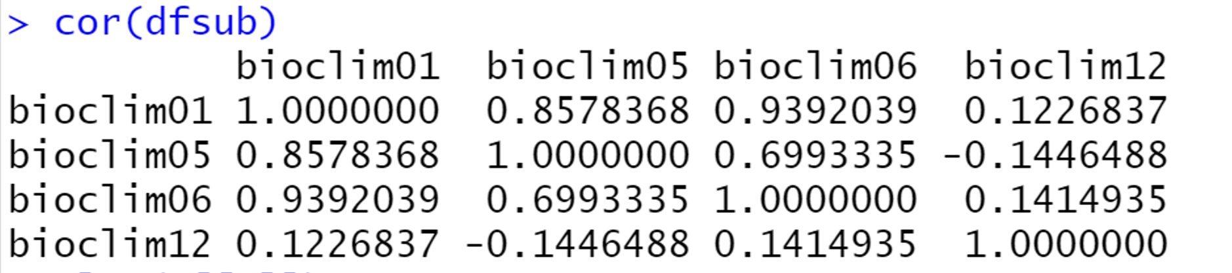
Correlation between four selected variables
df<-getValues(rsub)
dfsub<-df[sample(nrow(df), 1000),c(1,5,6,12)]
dfsub<-na.omit(dfsub)
pairs(dfsub)
Bioclim01: Annual Mean Temperature
Bioclim05: Max Temperature of Warmest Month
Bloclim06: Min Temperature of Coldest Month
Bioclim12: Annual Precipitation
High intercorrelations among two or more independent variables
-> multicollinearity leads to wider confidence intervals
Model results are difficult to interpret

Slide 12
pca <- prcomp(dfsub, scale. = TRUE) #PCA function
PCA results
pca$x -> transformed variables (now called PC1, PC2, PC3, PC4)
uncorrelated components

Slide 13
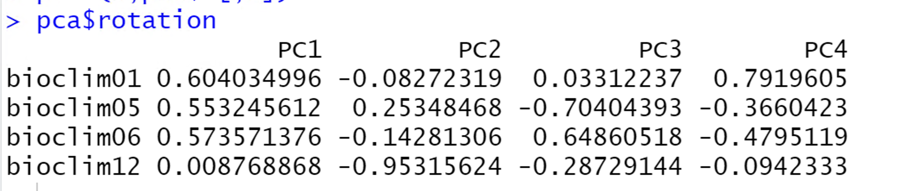
PCA results: Transformation or rotation coefficients
pca$rotation
PC1=Bioclim01*0.604 + bioclim05*0.553+bioclim06*0.573+bioclim12*0.0088
PC2=….

Slide 14
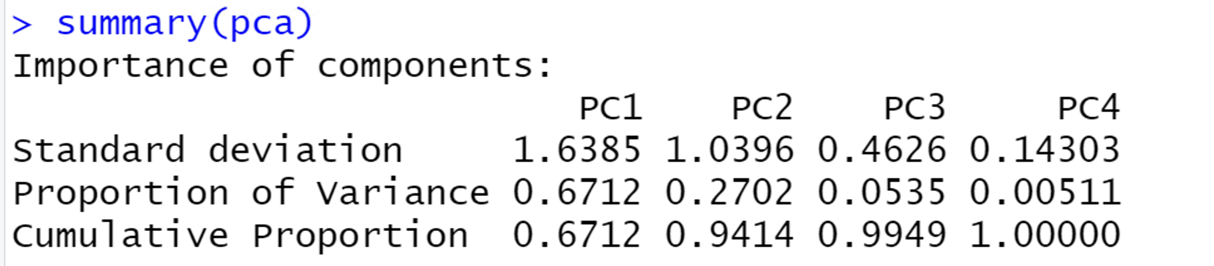
PCA results: Eigenvalues
the variances explained by the principal components (one for each component)
pca$sdev
[1] 1.6385071 1.0396339 0.4625979 0.1430347
PC1 PC2 PC3 PC4

Slide 15
PCA for all data points? (without sampling)
dfsub<-df[sample(nrow(df), 1000),c(1,5,6,12)]

Slide 16
PC1 map PC2 map PC3 map

Slide 17
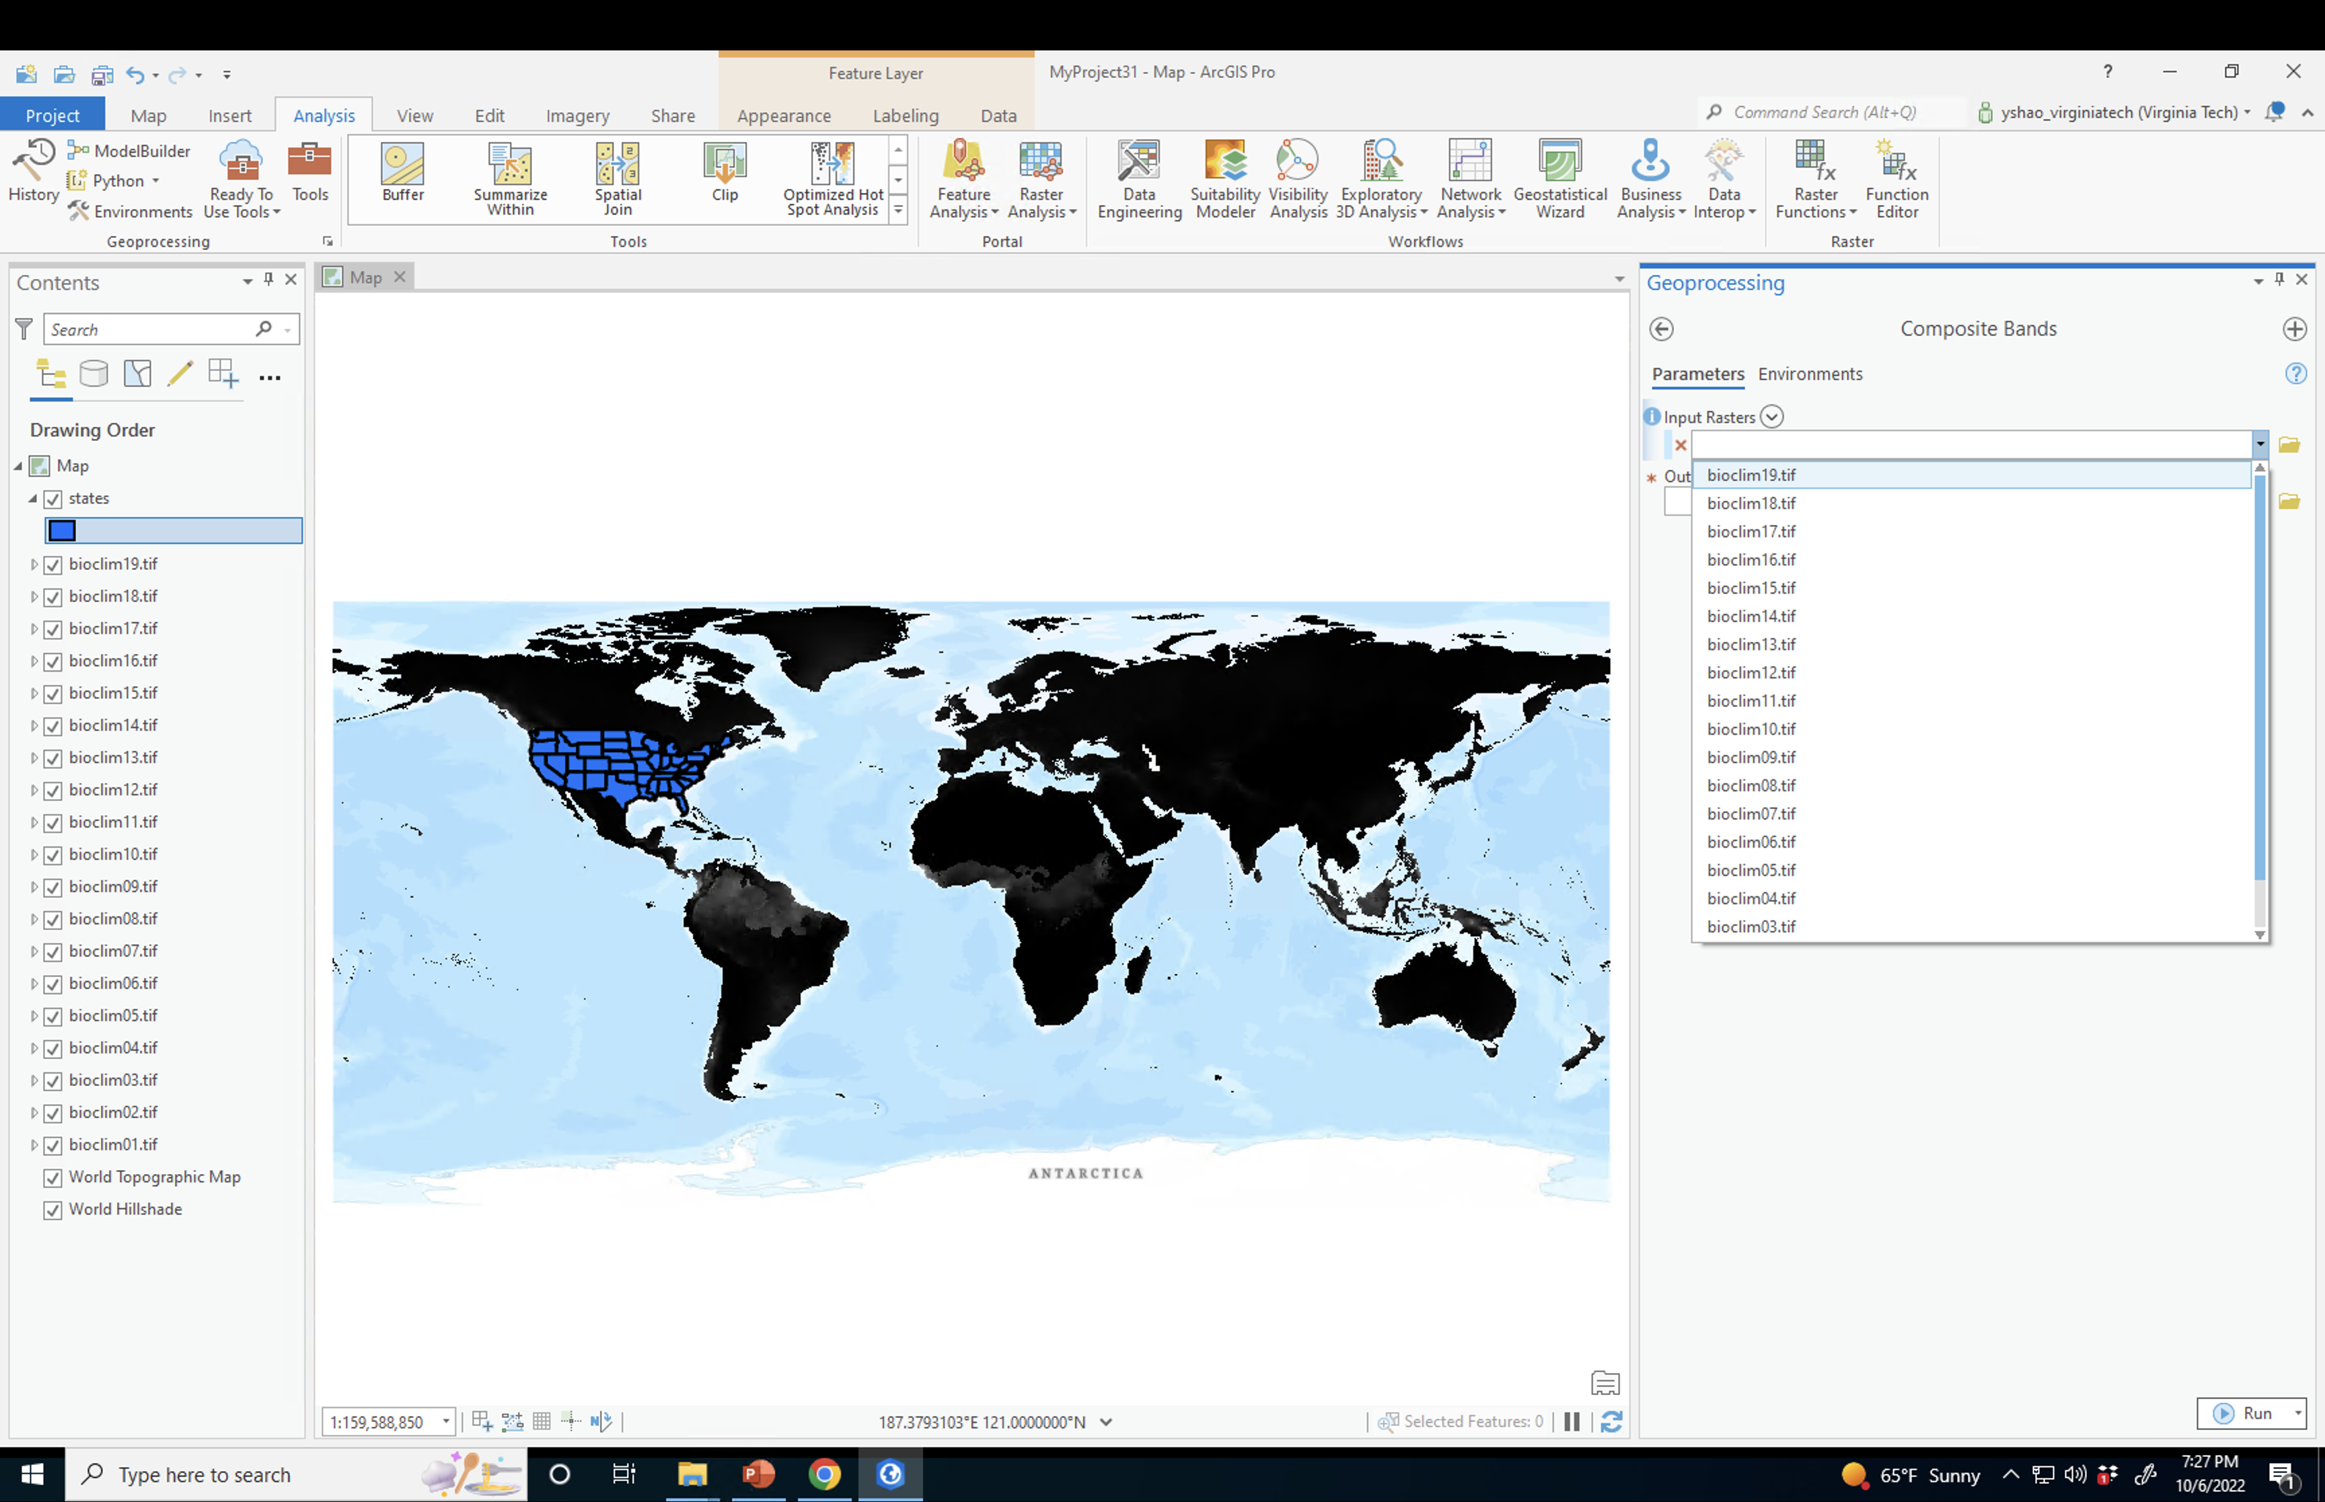
Arcgis tools:
Clip raster
Composite bands

Slide 18
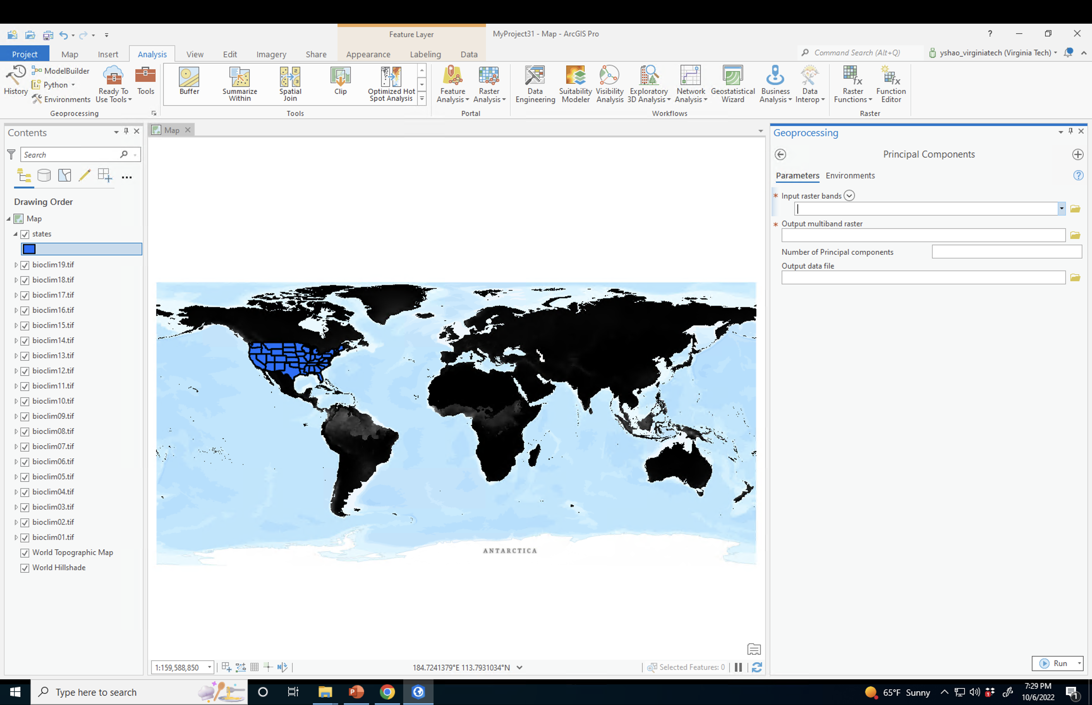

Slide 19
K-means clustering on PCA image
n=8
k <- kmeans(pca$x[,1:8], centers = n, nstart = 25)
k_label<-k$cluster

Slide 20
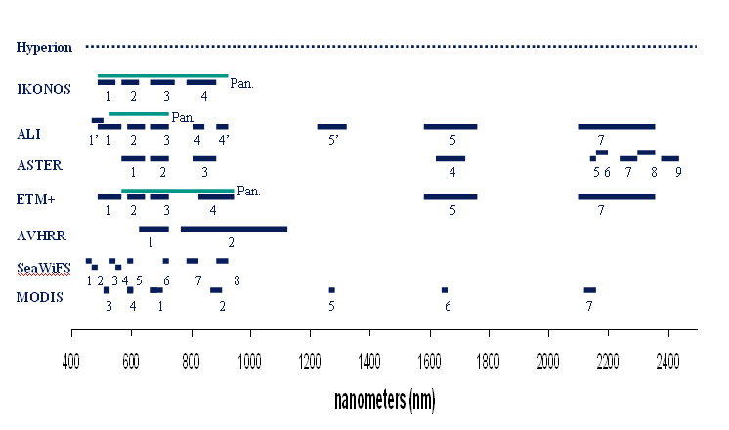
Hyperspectral Data and PCA

Slide 21
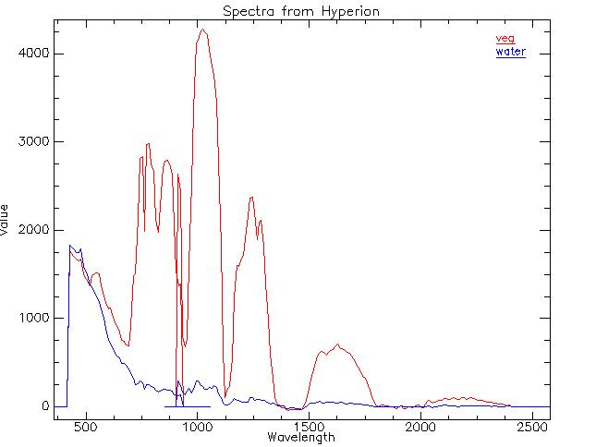
Hyperspectral Data and PCA

Slide 22
hyperspectral.tif
rgb3band.tif

